Slide 1
RESUME PARSER WITH NLP
PROJECT GUIDE: Ms. K.GAYATHRI
BY
ARULRAJ S (18MX203)
BALA RAJENDRA KUMAR R A (19MX151)

Slide 2
AGENDA
Outcome of the project
Existing System
Proposed System
Tools and Technologies
System Flow
Implementation

Slide 3
OBJECTIVE
To develop a web application that can help the Online Recruitment Process(ORS).
To design a model that can parse information from unstructured resumes and transform it to a structured JSON format.
Suggest appropriate jobs to the candidates.
Suggest only the eligible candidates to the recruiters based on the job description.

Slide 4
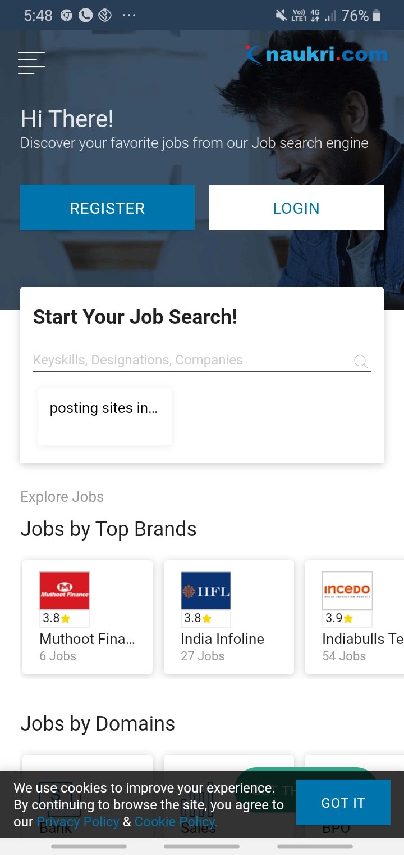
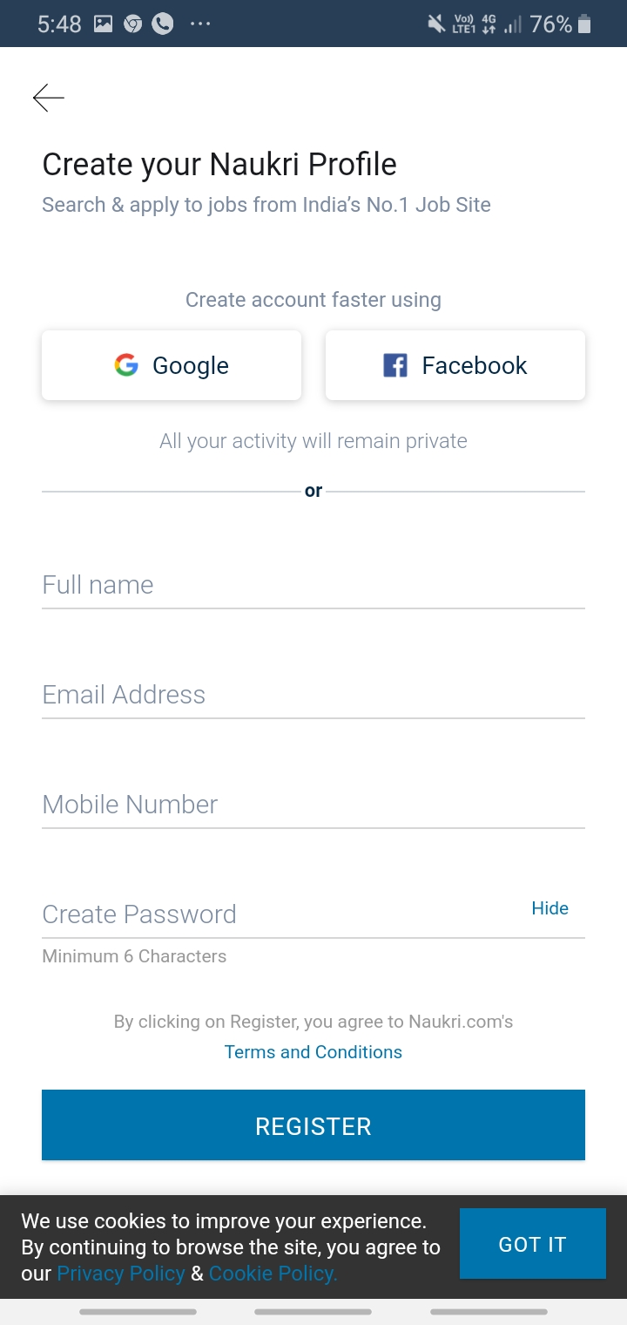
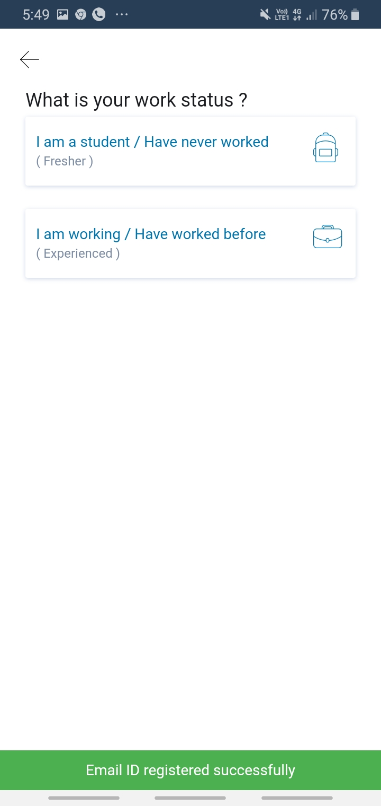
HOW EXISTING SYSTEM WORKS?

Slide 5
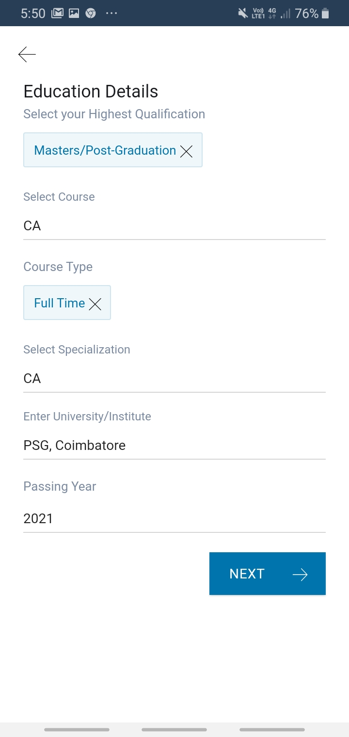
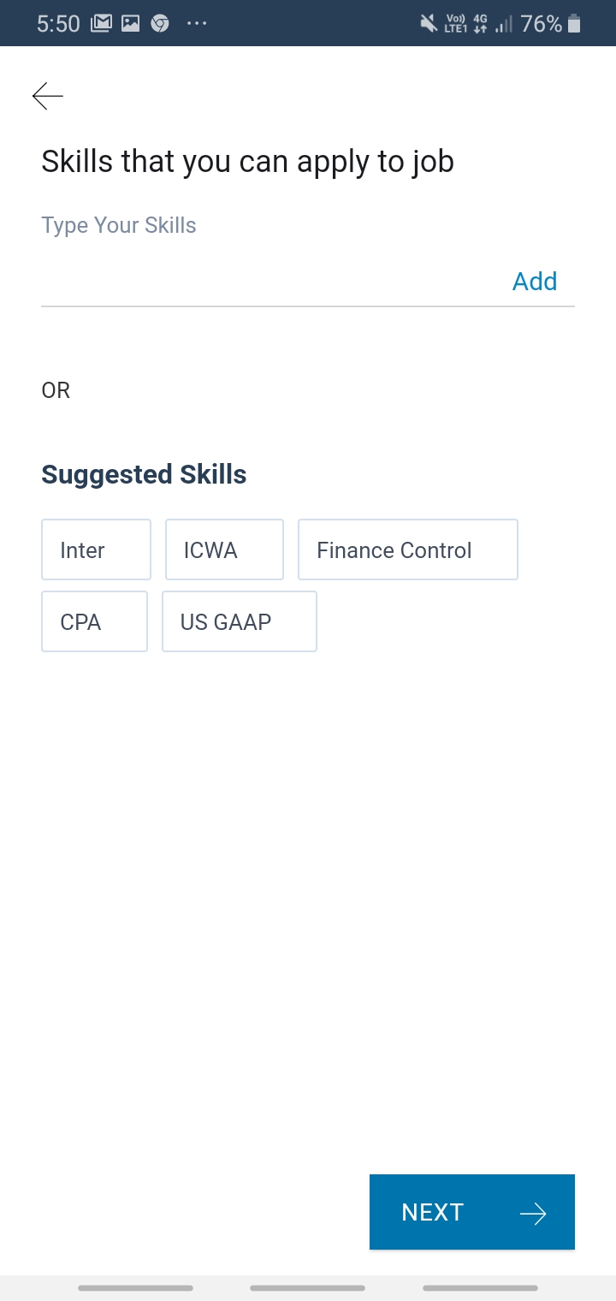
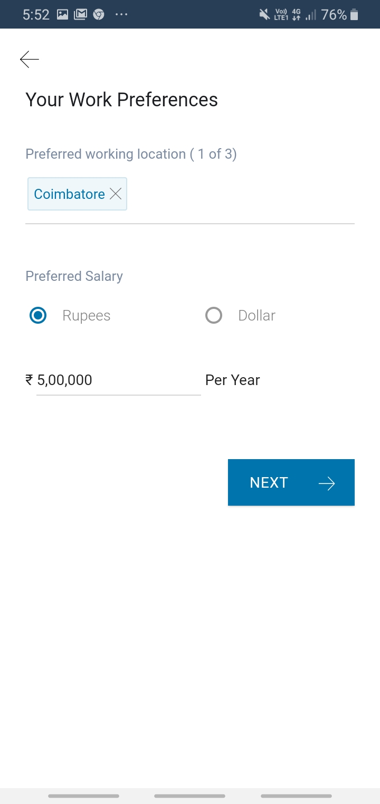
HOW EXISTING SYSTEM WORKS?

Slide 6
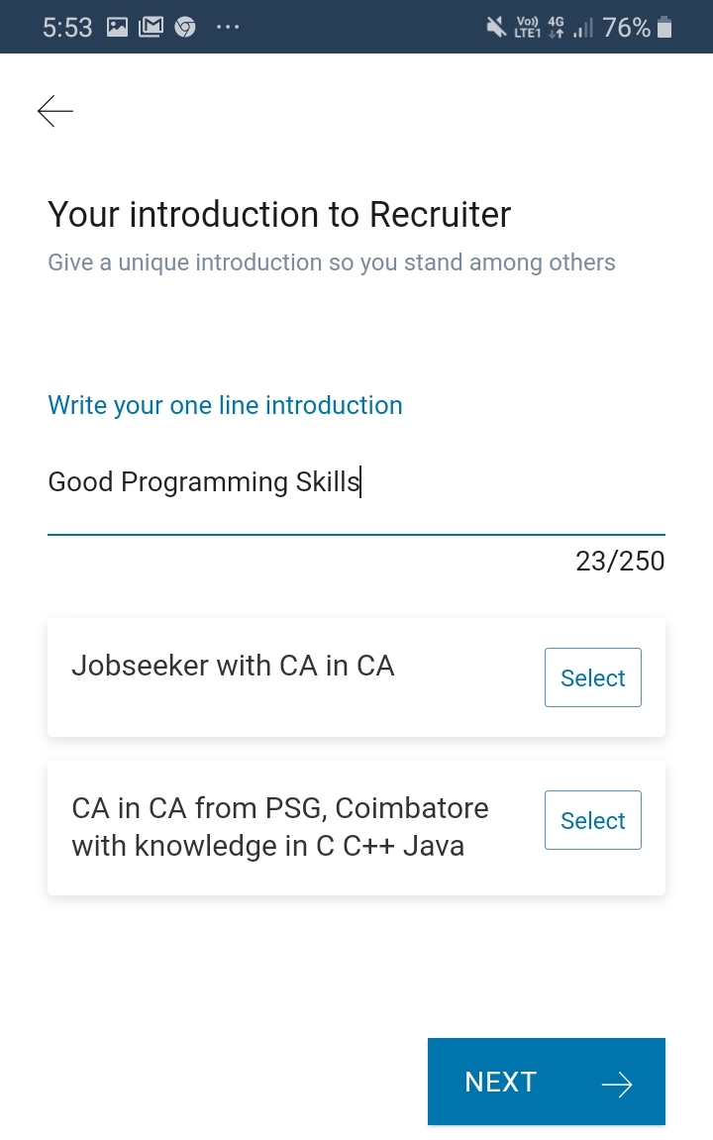
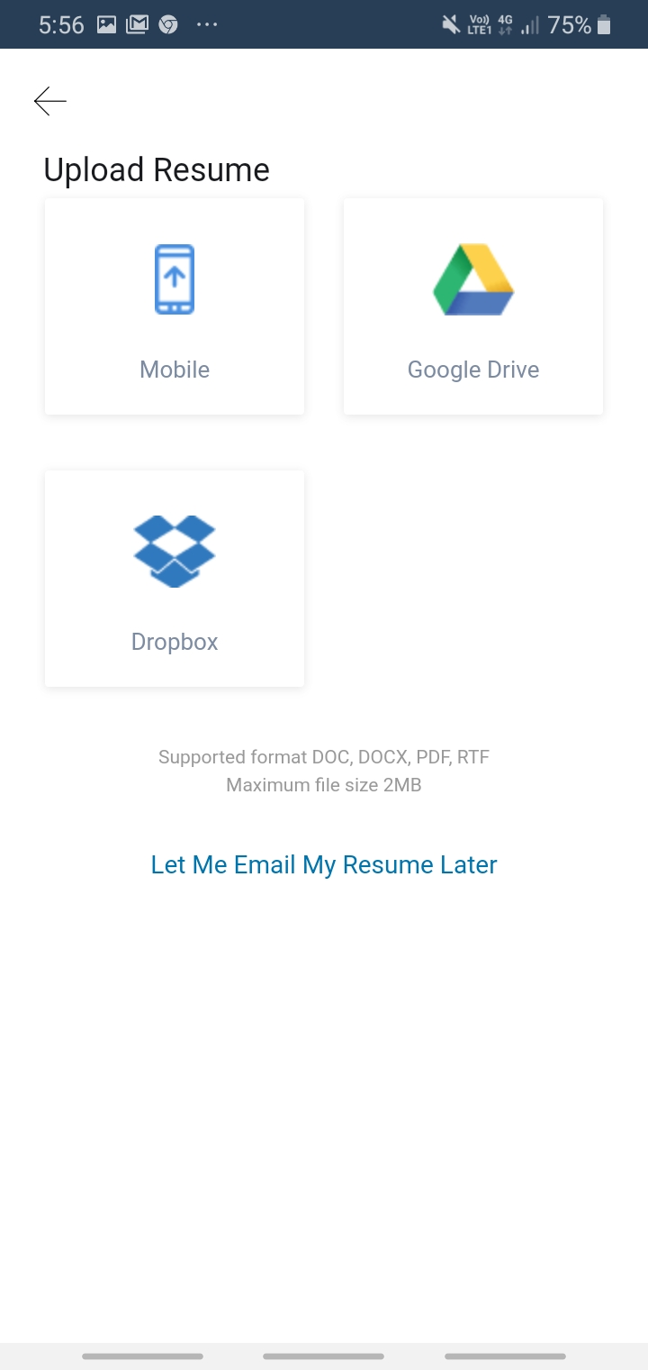
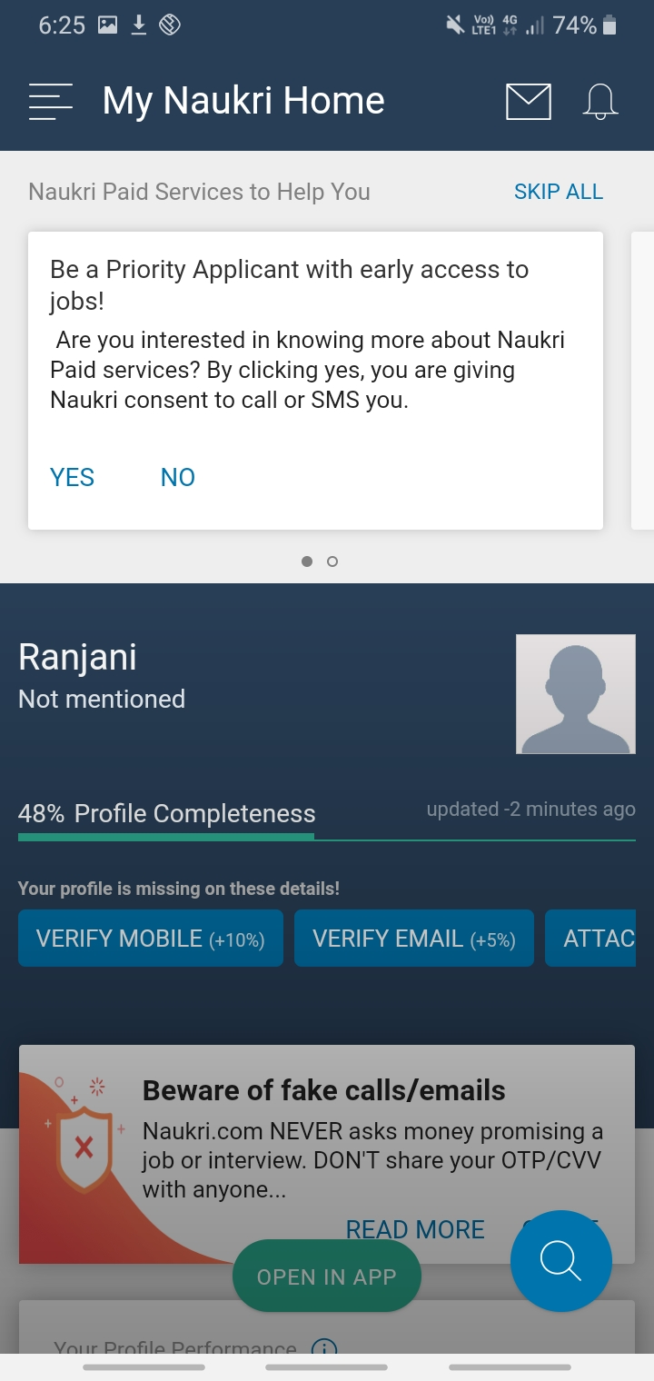
HOW EXISTING SYSTEM WORKS?

Slide 7
DRAWBACKS OF EXISTING SYSTEM
Job portals are interface between recruiter and job seeker
Needs high storage repository to store all resumes
Existing job portals may not secured
Frequent job offers will be only visible for paid candidates
Each candidate must pay the amount for frequent job offers
Resumes must be in a predefined format
Each resume must have a header information consist of 256 characters

Slide 8
NEW FEATURES IN THE PROPOSED SYSTEM
Only the registered recruiters can view the list of eligible candidates. So secured
Resume parser is free of cost
No need to store the resumes of all candidates into the database
Resume parser will store only the extracted information from resumes into the database
Resume data is extracted and stored in JSON format
No predefined format and structure of resume.

Slide 9
TOOLS & TECHNOLOGIES
SPYDER
Spyder is an open source cross platform IDE
Used for scientific programming in the Python language.
Spyder integrates with a number of prominent packages including NumPy, SciPy, Matplotlib, pandas
PYTHON
Powerful and efficient programming language
Python can be used on a server to create web applications
Contains huge set of libraries and packages

Slide 10
FLASK
Flask is a web application framework written in Python.
Web application framework = Collection of libraries and modules that enables a web application developer to write applications
Third party python library
NLTK
NLTK stands for Natural Language Toolkit.
Powerful NLP library which contains packages to make machines understand human language and reply to it with an appropriate response.

Slide 11
SQLITE
Server-less database
Server-less means there is no need to install a separate server to work with SQLite
One can connect directly with the database.
SQLite is a lightweight database that can provide a relational database management system (RDBMS) with zero-configuration because there is no need to configure or setup anything to use it.

Slide 12
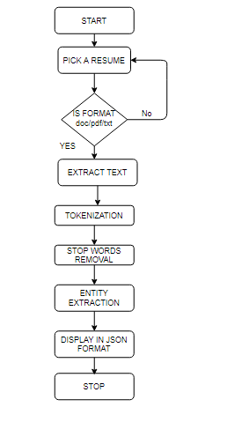
SYSTEM FLOW

Slide 13
UPLOAD FILE
from flask import Flask
UPLOAD_FOLDER = F:/SEMESTER4/MINI_PROJECT/pdf_to_text/Uploads'
app = Flask(__name__)
app.config['UPLOAD_FOLDER'] = UPLOAD_FOLDER
app.config['MAX_CONTENT_LENGTH'] = 16 * 1024 * 1024

Slide 14
CONVERTING PDF FILES INTO TEXT
import PyPDF2
if(ext==".pdf"):
pdfFileObj = open(filename, 'rb')
pdfReader = PyPDF2.PdfFileReader(pdfFileObj)
x=pdfReader.numPages
for i in range(1,x):
pageObj = pdfReader.getPage(i)
ans=pageObj.extractText()
content=content+ans

Slide 15
CONVERTING DOCUMENT INTO TEXT
import docx2txt
if(ext==".docx"):
content = docx2txt.process(filename)
if(ext==".txt"):
tfobj=open(filename,'r')
content=tfobj.read()

Slide 16
TOKENIZATION
In Python Tokenization basically refers to splitting up a larger body of text into smaller lines, words or even creating words for a non-English language.
The various tokenization functions in-built into the nltk module itself.
from nltk.tokenize import word_tokenize
word_tokens = word_tokenize(content)

Slide 17
STOPWORD REMOVAL
In natural language processing, useless words (data), are referred to as stop words.
A stop word is a commonly used word (such as “the”, “a”, “an”, “in”)
Stop words also consume memory space in Database
Stop words are the English words which does not add much meaning to a sentence.
They can safely be ignored without sacrificing the meaning of the sentence.
Such words are already captured this in corpus named corpus.

Slide 18
STOPWORDS IN NLP
{‘ourselves’, ‘hers’, ‘between’, ‘yourself’, ‘but’, ‘again’, ‘there’, ‘about’, ‘once’, ‘during’, ‘out’, ‘very’, ‘having’, ‘with’, ‘they’, ‘own’, ‘an’, ‘be’, ‘some’, ‘for’, ‘do’, ‘its’, ‘yours’, ‘such’, ‘into’, ‘of’, ‘most’, ‘itself’, ‘other’, ‘off’, ‘is’, ‘s’, ‘am’, ‘or’, ‘who’, ‘as’, ‘from’, ‘him’, ‘each’, ‘the’, ‘themselves’, ‘until’, ‘below’, ‘are’, ‘we’, ‘these’, ‘your’, ‘his’, ‘through’, ‘don’, ‘nor’, ‘me’, ‘were’, ‘her’, ‘more’, ‘himself’, ‘this’, ‘down’, ‘should’, ‘our’, ‘their’, ‘while’, ‘above’, ‘both’, ‘up’, ‘to’, ‘ours’, ‘had’, ‘she’, ‘all’, ‘no’, ‘when’, ‘at’, ‘any’, ‘before’, ‘them’, ‘same’, ‘and’, ‘been’, ‘have’, ‘in’, ‘will’, ‘on’, ‘does’, ‘yourselves’, ‘then’, ‘that’, ‘because’, ‘what’, ‘over’, ‘why’, ‘so’, ‘can’, ‘did’, ‘not’, ‘now’, ‘under’, ‘he’, ‘you’, ‘herself’, ‘has’, ‘just’, ‘where’, ‘too’, ‘only’, ‘myself’, ‘which’, ‘those’, ‘i’, ‘after’, ‘few’, ‘whom’, ‘t’, ‘being’, ‘if’, ‘theirs’, ‘my’, ‘against’, ‘a’, ‘by’, ‘doing’, ‘it’, ‘how’, ‘further’, ‘was’, ‘here’, ‘than’}

Slide 19
REMOVING STOPWORDS
import nltk
from nltk.corpus import stopwords
nltk.download('stopwords')
stop_words = set(stopwords.words('english'))
filtered_sentence = []
for w in word_tokens:
if w not in stop_words and w not in filtered_sentence:
filtered_sentence.append(w)
print(filtered_sentence)

Slide 20
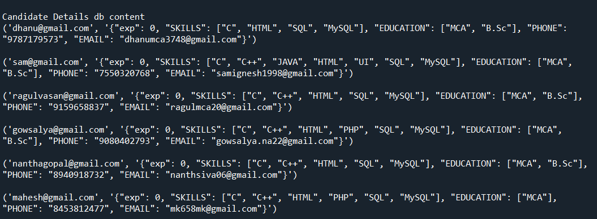
ENTITY EXTRACTION INTO JSON

Slide 21
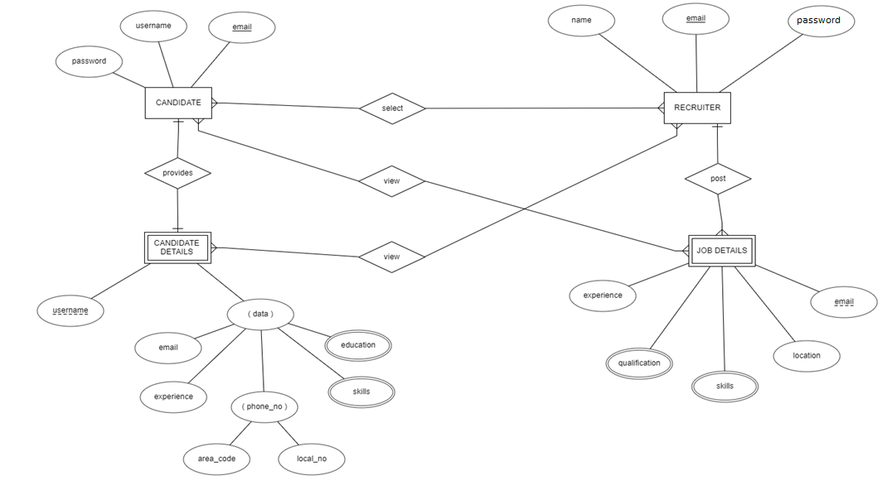
ENTITY RELATIONSHIP DIAGRAM

Slide 22
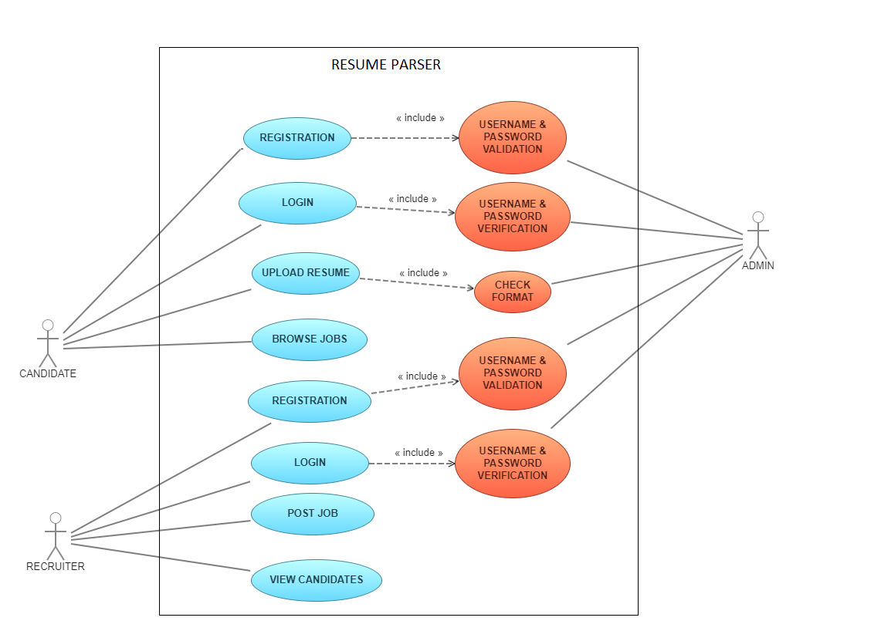
USE CASE DIAGRAM

Slide 23
Overall learning
Ability to connect python and HTML
Learnt a new web application framework Flask
Reading text from multiple formats of resume
Entity extraction and Converting entities to JSON format

Slide 24
Future enhancements
Trying to extract resumes from different social networking sites
These sites includes Stack Overflow, LinkedIn, Facebook etc.
Resumes can be categorized based on the genre (example : IT related, Engineering, Accounts, Sales, etc ).
The system should be able to find similarities between the resumes.

Slide 25
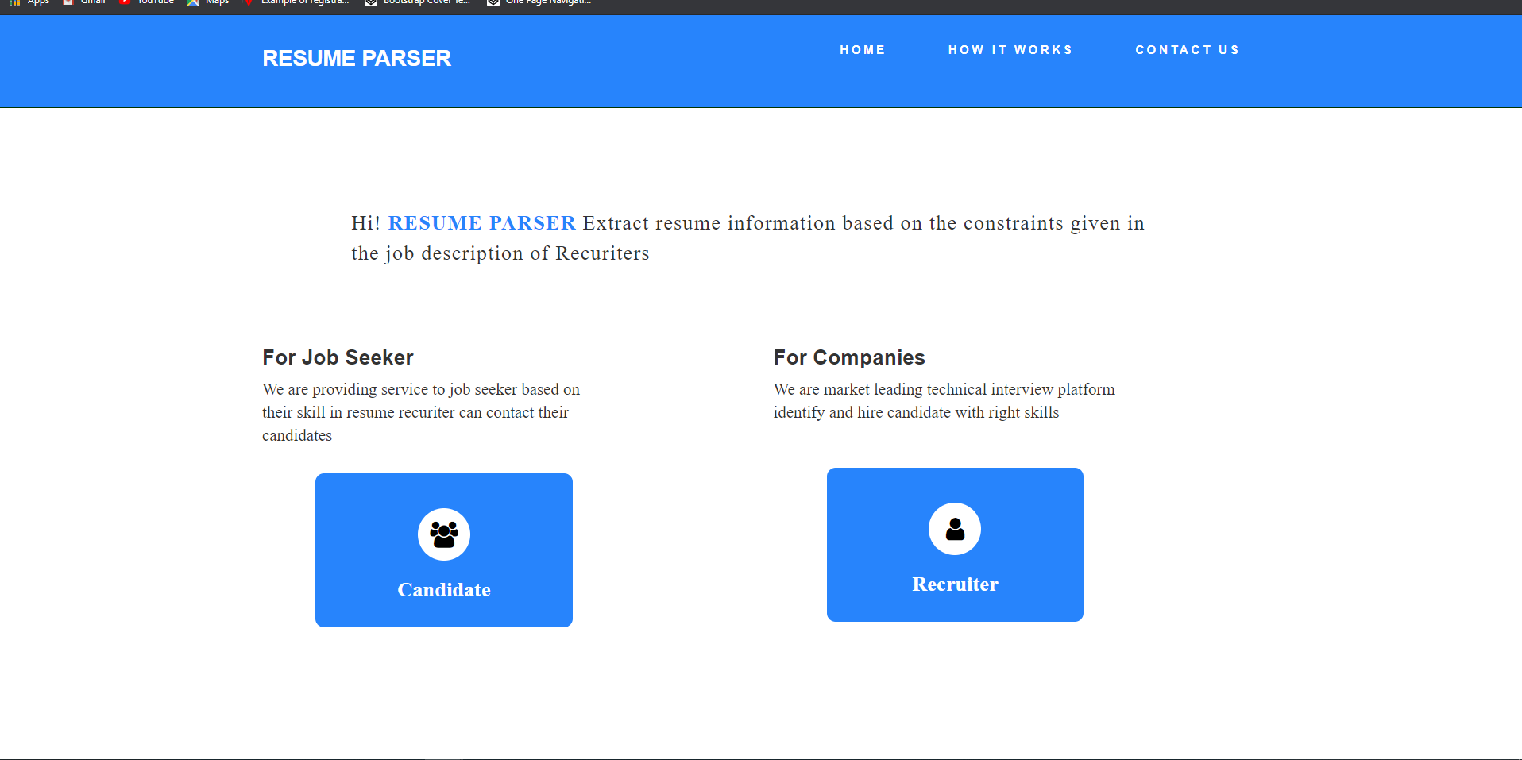
USER INTERFACE DESIGN

Slide 26
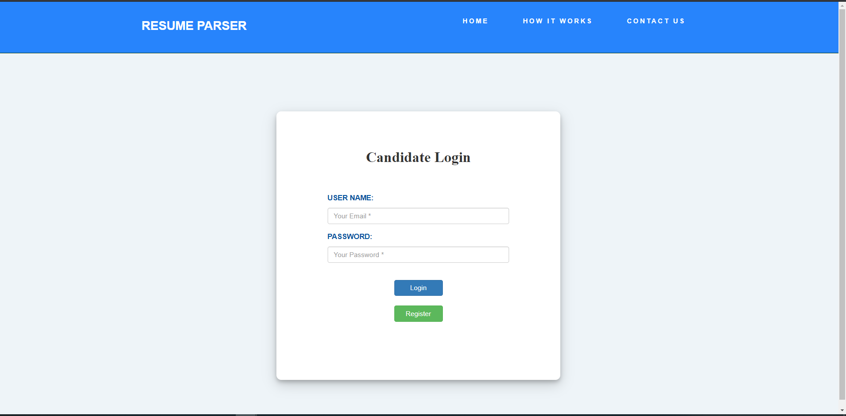

Slide 27
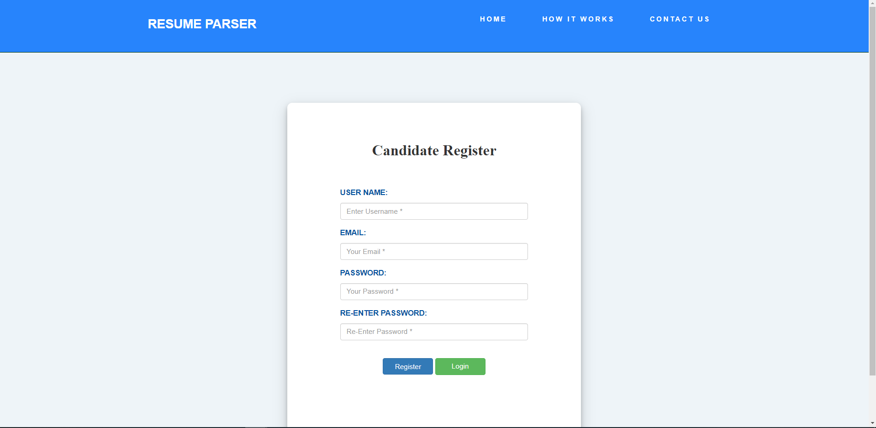

Slide 28
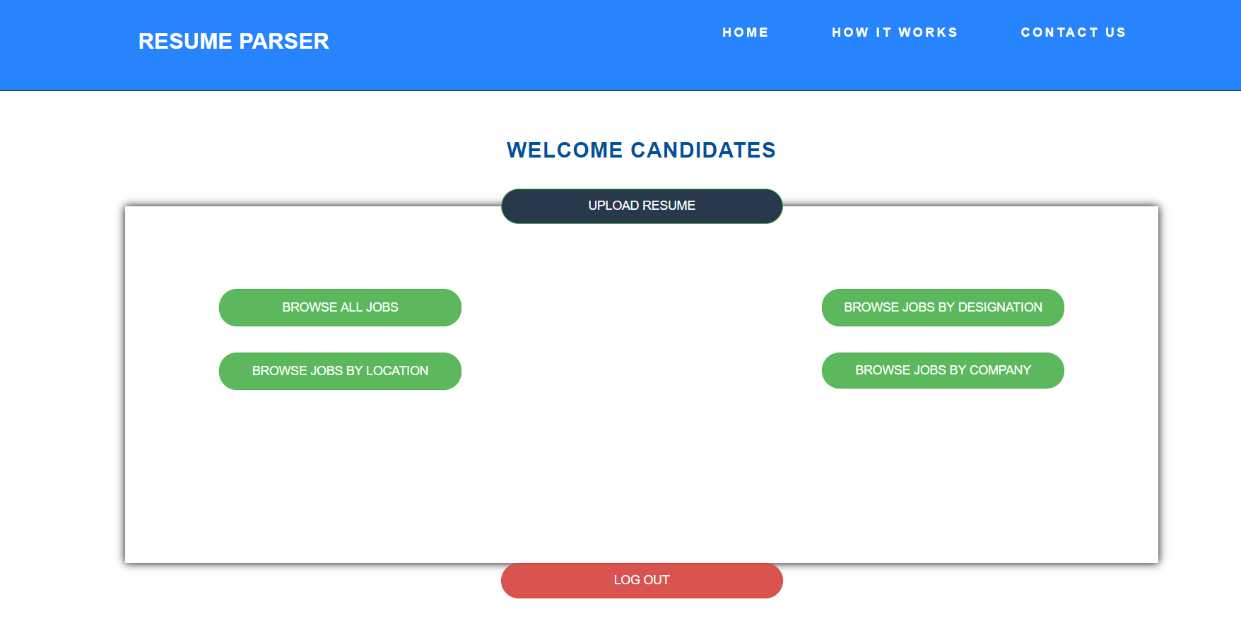

Slide 29
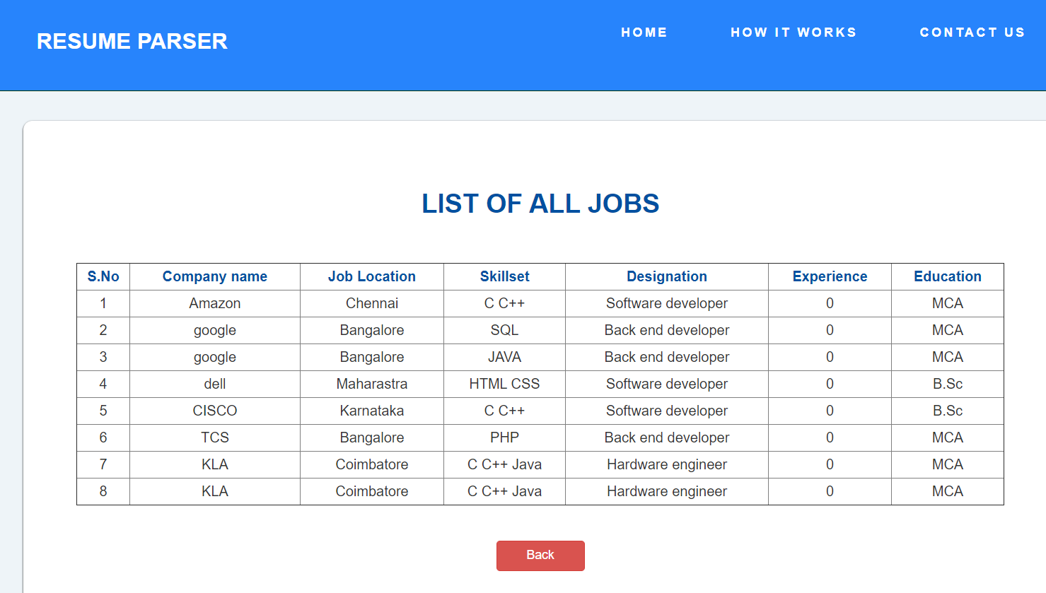

Slide 30
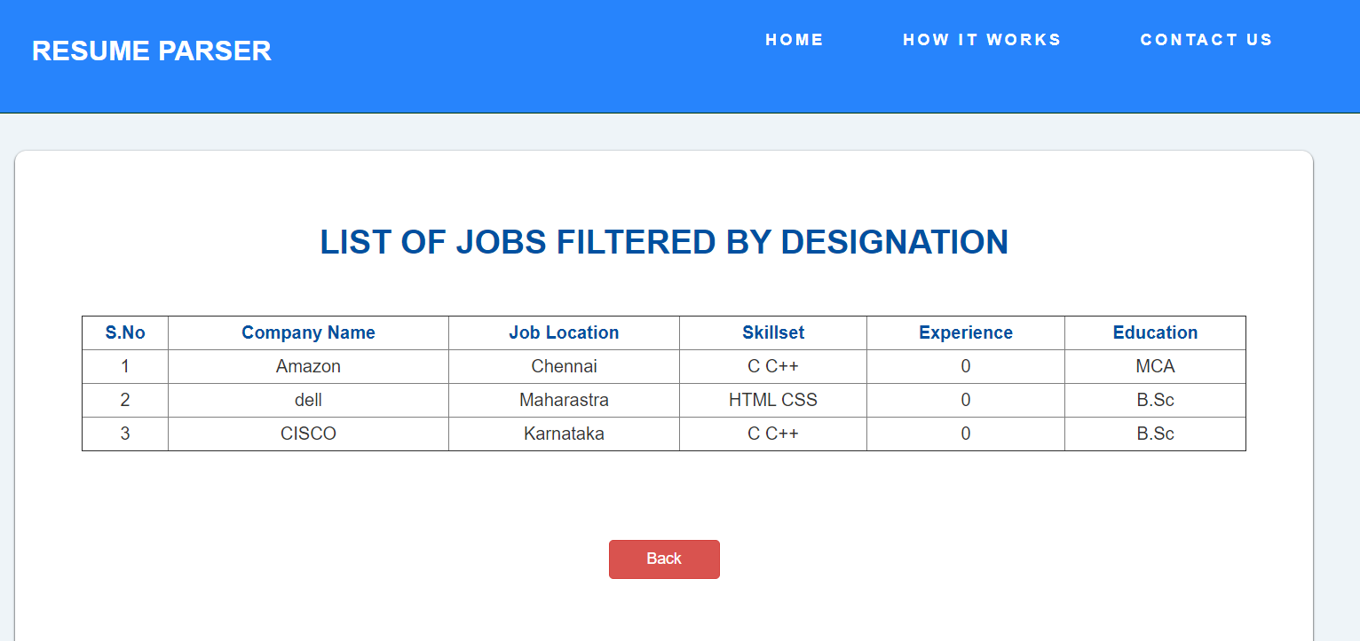

Slide 31
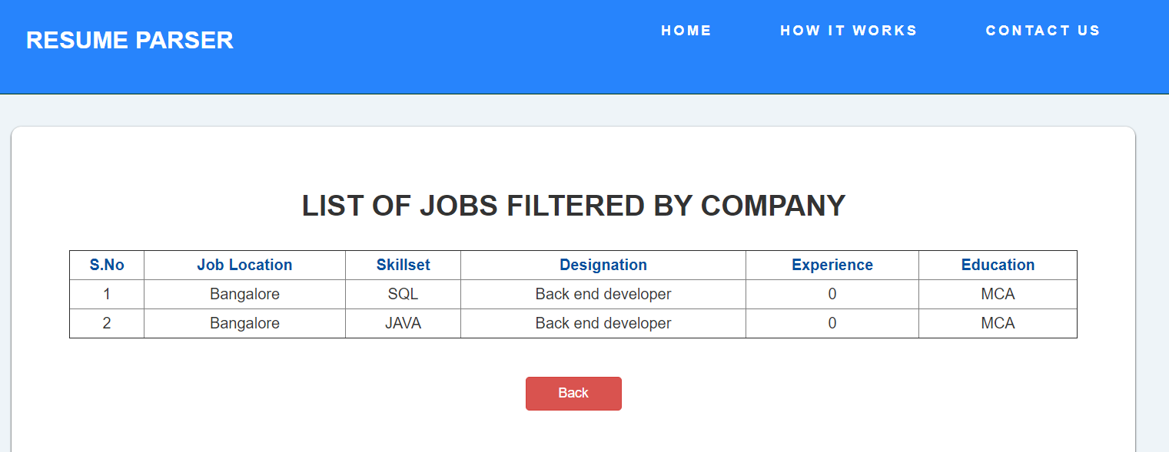

Slide 32
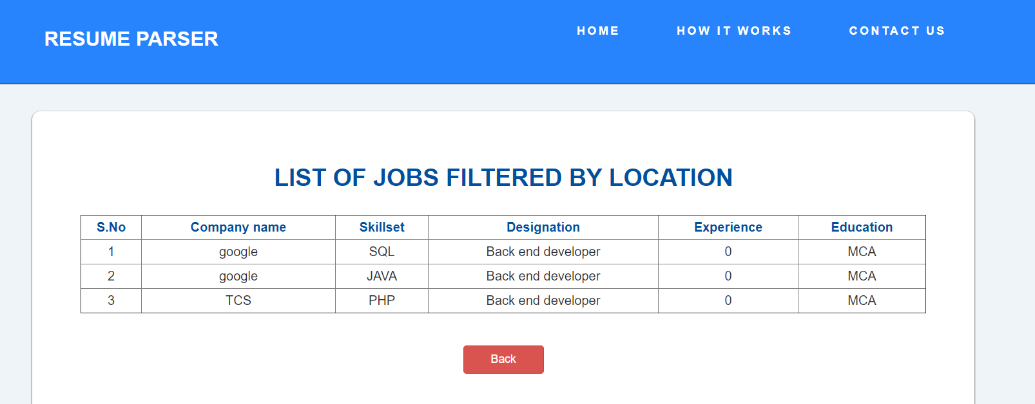

Slide 33
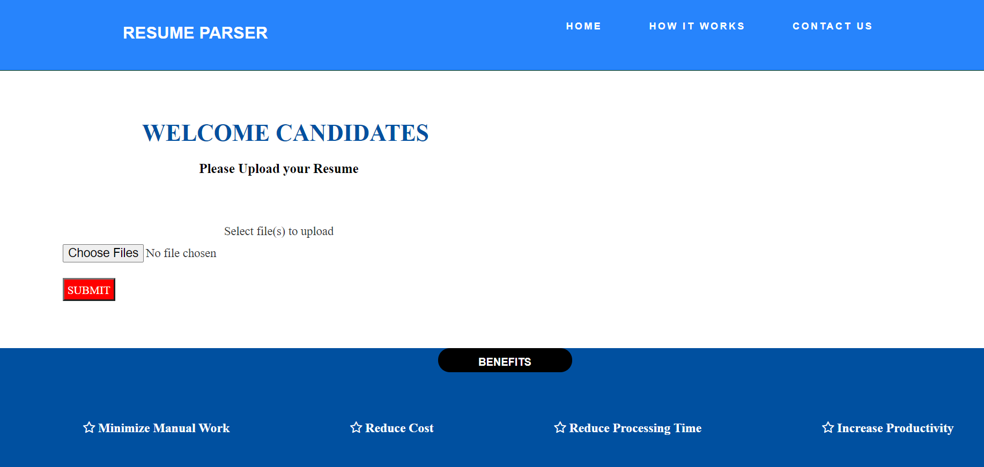

Slide 34
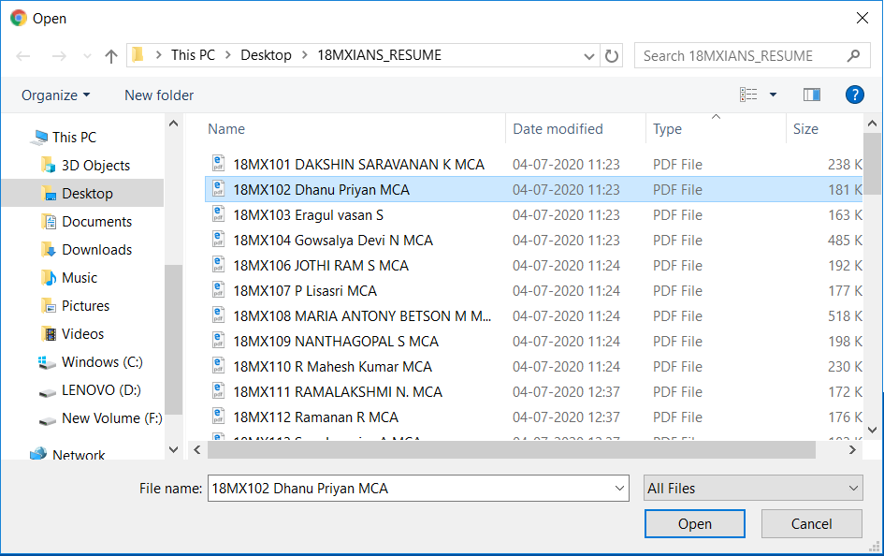

Slide 35
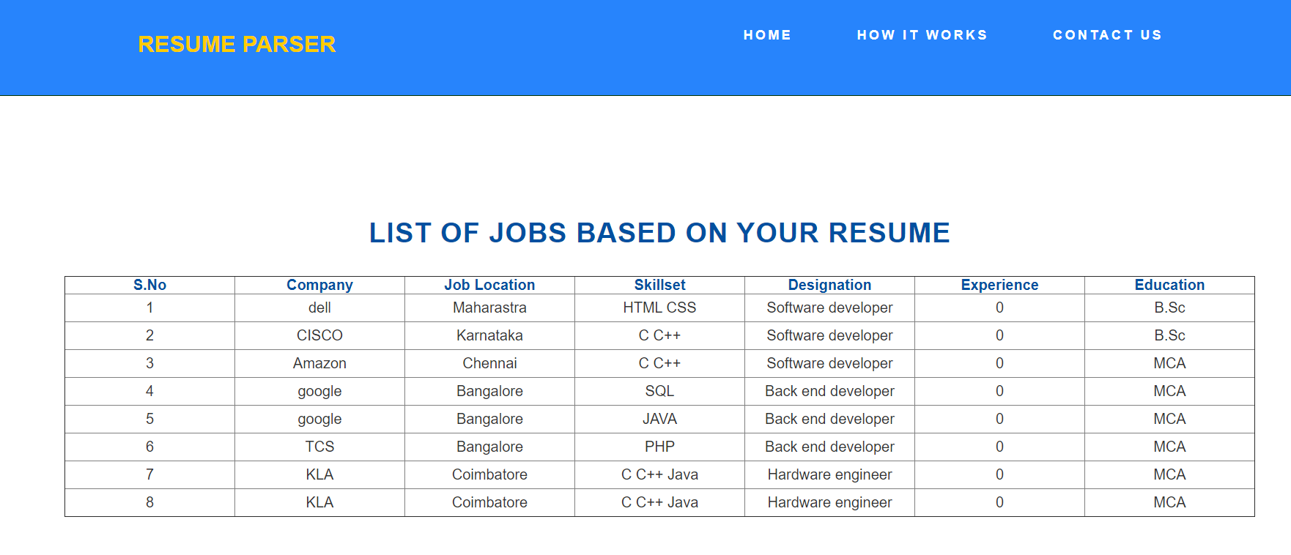

Slide 36
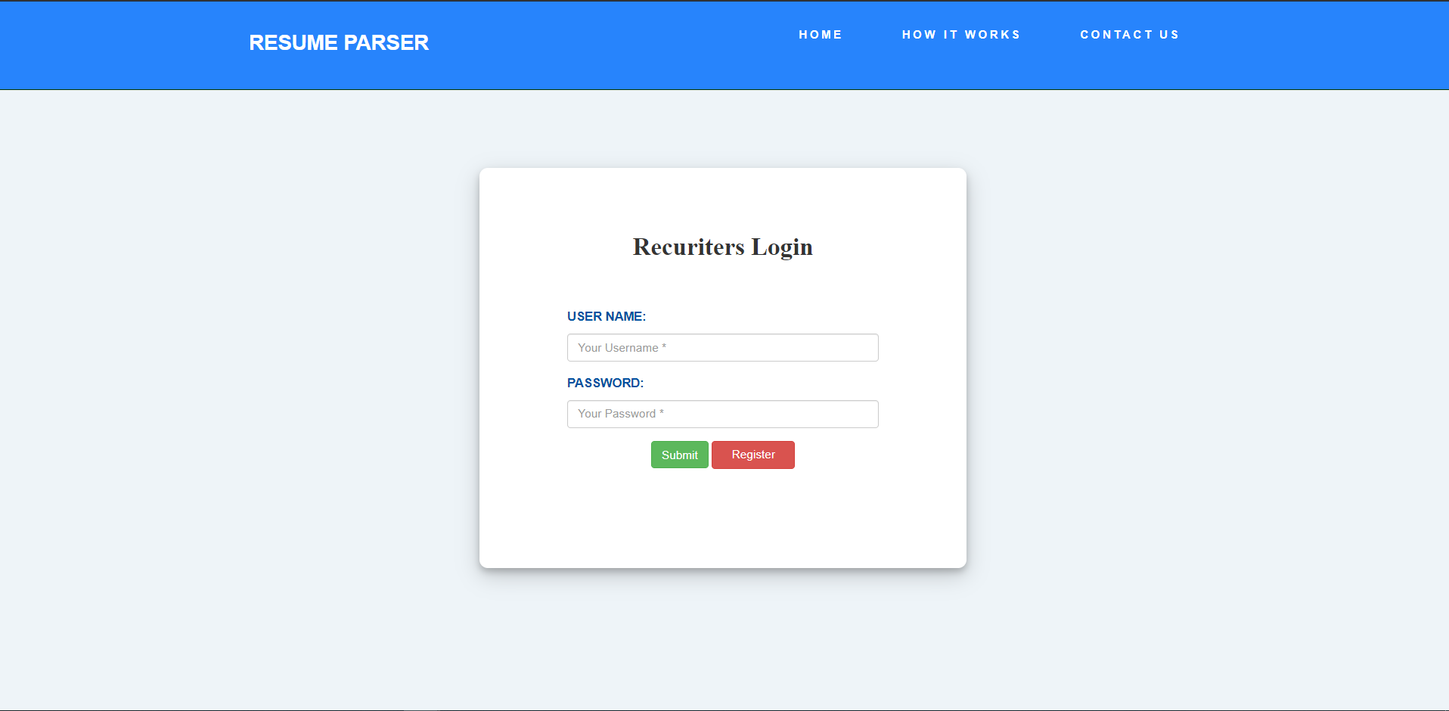

Slide 37
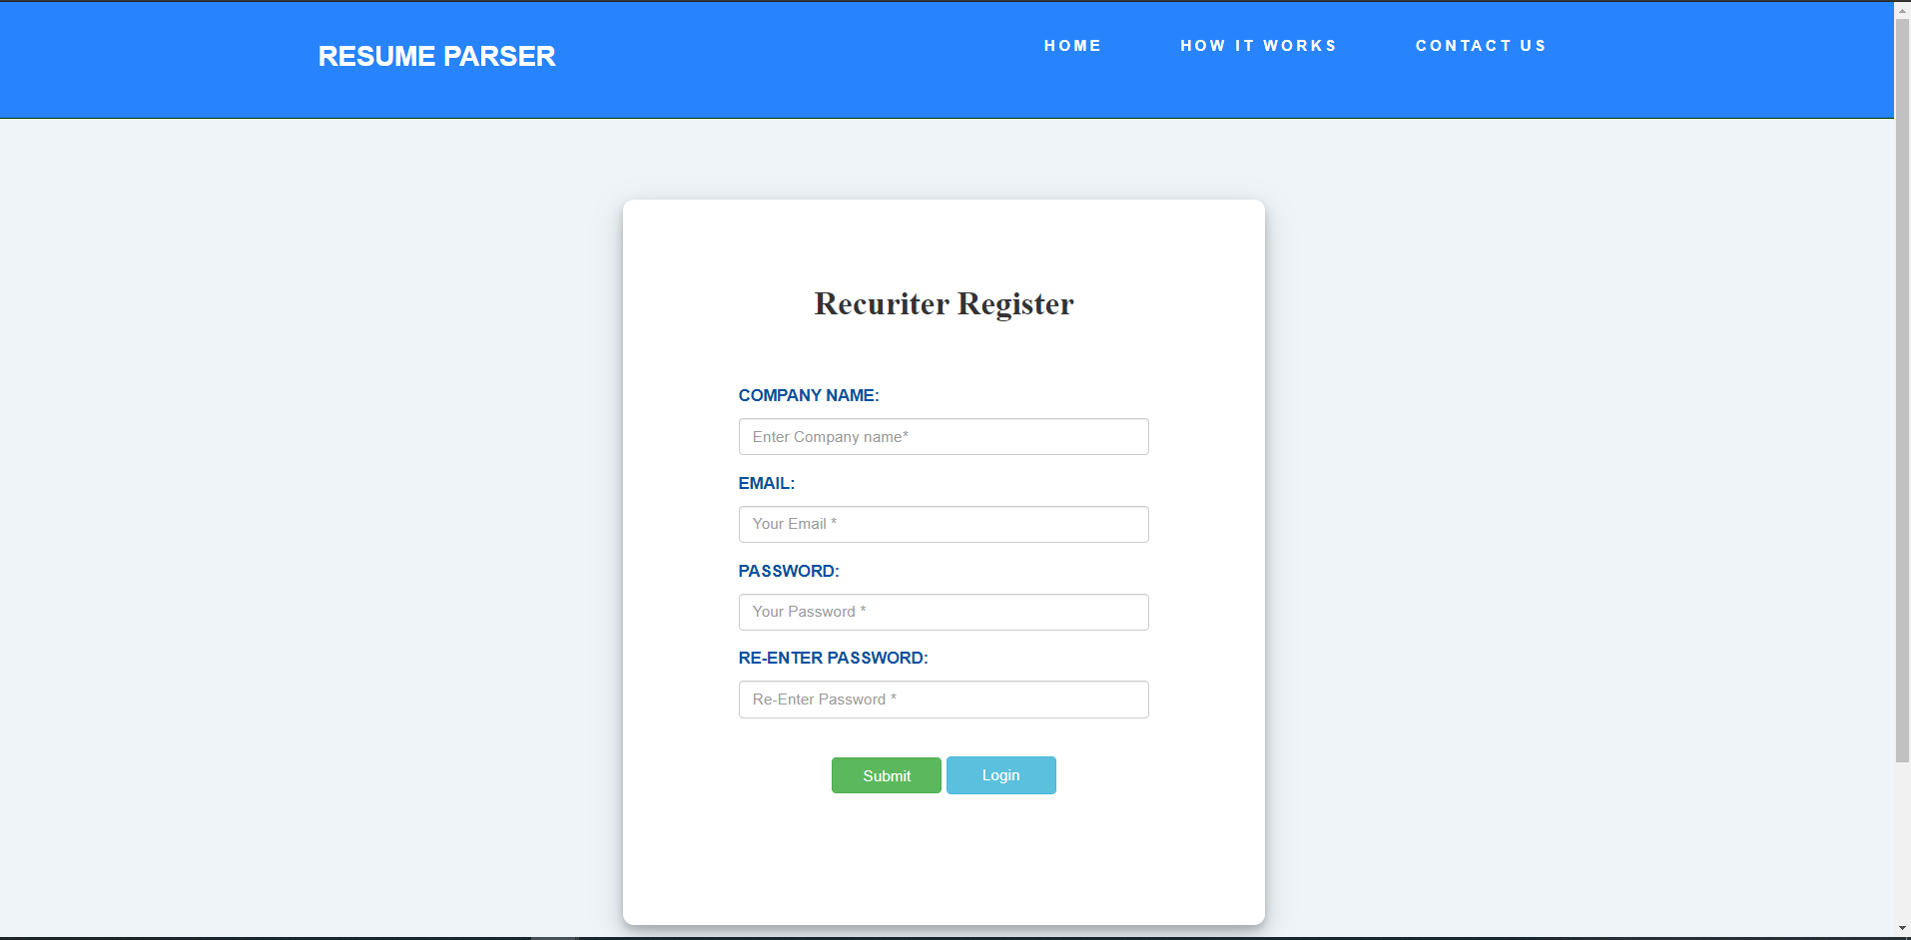

Slide 38
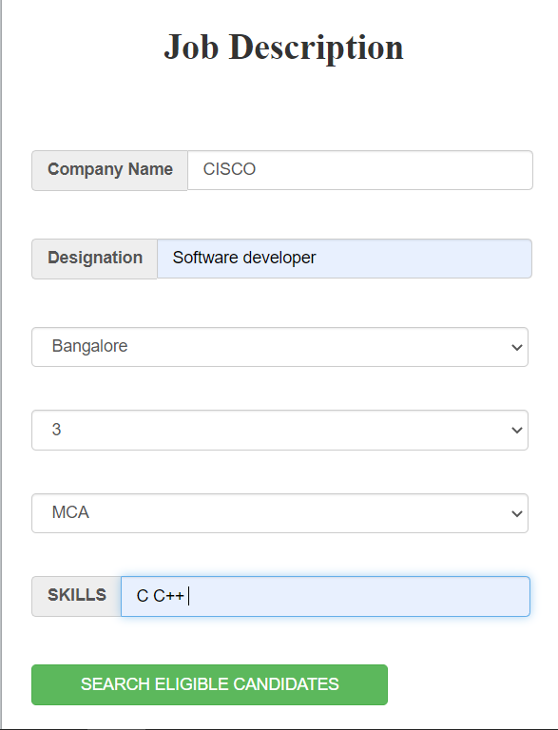

Slide 39
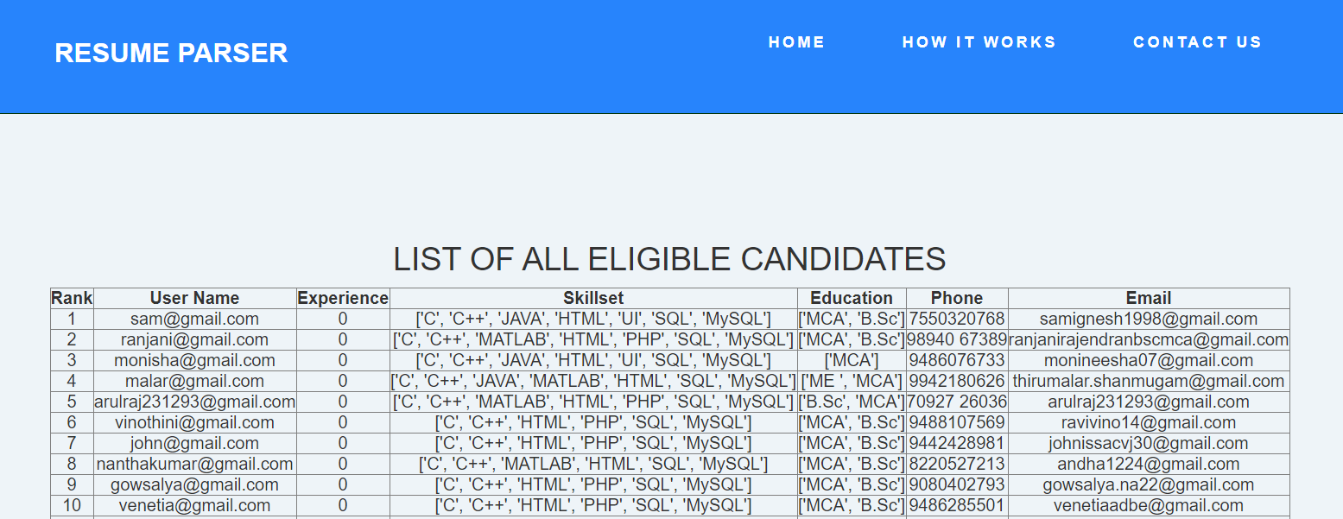

Slide 40
QUERIES?

